Slide 1
EU funding for transport infrastructure
Josef Schwarz
Representation of the European Commission
in the Czech Republic
22 September 2022

Slide 2
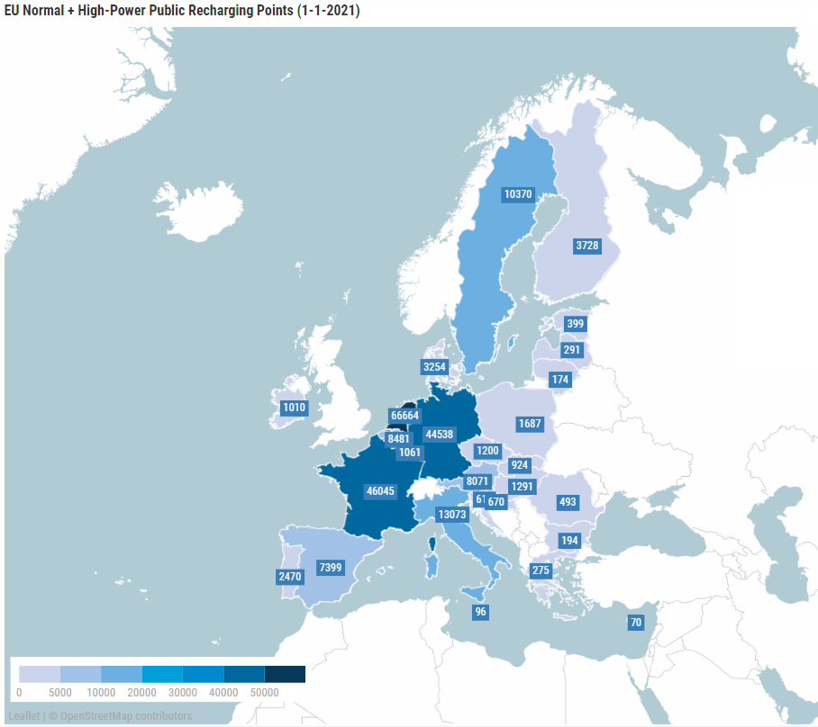

Lack of coherence in recharging roll-out
More than 70% of all public accessible recharging points located in three Member States
Around 700,000 recharging points risk to be missing by 2030 in 17 Member States if no additional policy action is taken

Slide 3
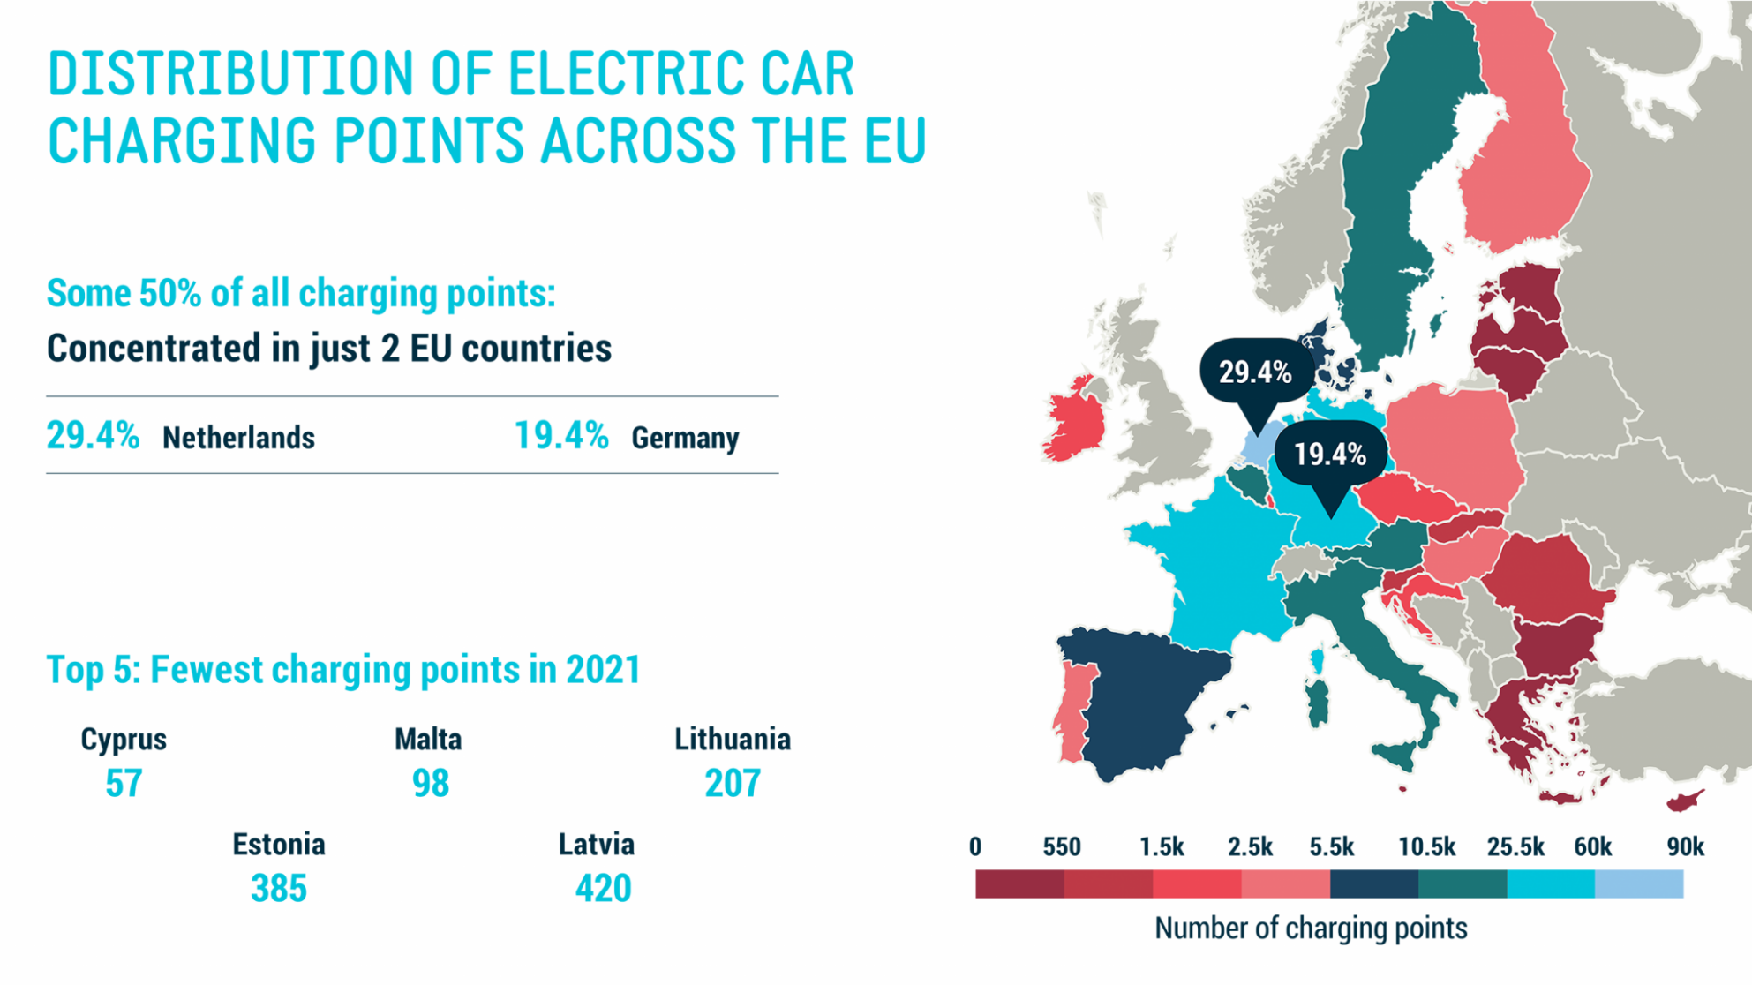
Source: https://www.acea.auto/press-release/electric-cars-half-of-all-chargers-in-eu-concentrated-in-just-two-countries/

Slide 4
EU funding for 2021 - 2027
Components |  | Manufacturing |  | Infrastructure |  | Fleets |  | Clean Fuels |  | Operations
RRF
InvestEU
EIB
 |  |  |  | ERDF - CF
 |  |  |  | CEF
Horizon EU
 |  |  |  |  |  |  |  | InnovFund

Slide 5
A consistent set of tools to deliver the Smart and Sustainable Mobility Strategy
€120-125 billion funding for transport (estimate)
A new era for financing sustainable transport
New EIB transport lending policy
InvestEU
Taxonomy on private financing
Broader investments benefitting transport (energy system integration, H2, digitalisation, AI, etc…)

Slide 6
Cohesion Fund and ERDF
Grants, shared management
2021-2027 Total Budget:
CF €32,5 billion ERDF €192,4 billion
20-25% for transport
Climate earmarking: 30%
Main focus
Key priorities
Investments for jobs and growth
Social and territorial cohesion
Connectivity TEN-T (around €15 billion)
Sustainable and green transport solutions
TEN-T
sustainable multimodal urban mobility (incl. fleets, rolling stock)
improving access at regional and local level to TEN-T and cross-border mobility
Just Transition Fund supports sustainable local transport

Slide 7
Connecting Europe Facility
Grants, direct management
2021-2027 Budget for transport:
€25.8 billion
Climate earmarking: 60%
Main focus
Key priorities
Development of sustainable transport infrastructure with high EU added value
Contribution to the completion of TEN-T core network by 2030
Greening and digitalising of transport and mobility
Railway
Large-scale deployment of alternative fuels infrastructure in all modes through new AF Facility
Digitalisation of transport and mobility systems by smart applications

Slide 8
2022 timeline: ongoing calls
Military Mobility call timetable
Call opening: | 12 May 2022
Deadline for submission: | 29 September 2022 – 17:00:00 CET (Brussels)
Evaluation: | October – December 2022
Information on evaluation results: | January 2023
Grant Agreement signature: | June 2023
CEF-T (general and cohesion envelope) call timetable (EUR 5.12 billion)
Call opening: | 13 September 2022
Info Day | 5 October 2022
Deadline for submission: | 18 January 2023 – 17:00:00 CET (Brussels)
Evaluation: | January – May 2023
Information on evaluation results: | June 2023
Grant Agreement signature: | October 2023
Selection of projects following the 2021 calls (7/2022) - CZ: 2+10

Slide 9


    Alternative Fuels Infrastructure Facility
    Locations
    On TEN-T road sections identified in the 2 “eligibility maps”:
    150 kW and above (incl. > 350 kW) & 350 kW https://ec.europa.eu/transport/infrastructure/tentec/tentec-portal/map/docs/AFIF1_2_150kw_350kw.pdf
    A buffer of 2km driving distance from the TEN-T road network is applicable, calculated from the closest exit.
Simulation Zoom : TENtec Public Viewer
http://ec.europa.eu/transport/infrastructure/tentec/tentec-portal/map/maps.html
Green: Non-eligible
Red: Eligible
Update of the maps:
Cut-off dates |  | MAPS
AFIF – 1 | 19 January 2022 | Version 1 of the MAPs | Published on 15/09/2021
AFIF – 2 | 07 June 2022
AFIF – 3 | 10 November 2022 | Version 2 of the MAPs | Published on 08/06/2022
AFIF – 4 | 13 April 2023
AFIF – 5 | 19 September 2023 | Version 3 of the MAPs | Published on 14/04/2023

Slide 10
Recovery and Resilience Facility
Grants and Loans, direct management, via national plans
2021-2023 Budget € 672,5 billion 10-20% grants for transport
Climate earmarking: 37%
Main focus
Transport priorities in RRPs
Mature investments & reforms
Aligned with CSRs
With high job and growth potential
Improving economic resilience
DNSH principle
€93 billion, including €15-20 billion for TEN-T
Recharge and Refuel EU flagship
Urban transport (public fleet greening, biking)
Rail infrastructure
Digitalisation
Only few aviation and maritime projects

Slide 11

Loans, guarantee, equity, Indirect management via EIB, EBRD and NPBs
2021-2027 Budget € 26.1 billion, SIW: € 10 billion, 430m advisory
(market/policy driven)
Climate earmarking for SIW: 60%
Main focus
Key priorities
Projects accelerating transition to sustainable transport
With risks limiting access to finance so far
Integrated approach accross various infra and equipment
Seamless support from R&D to full-scale deployment
Cleaner, Safe and Smart Mobility for all transport modes (and SMEs)
Future Mobility: Alternative fuels infrastructure & mobile assets (fleets); Digitalization and innovative business models
Development of TEN-T core network

Slide 12
Horizon Europe – Cluster 5 (Climate, Energy and Mobility)
Grants, direct management
2021-2027 Budget for the cluster:
€ 15 billion (plus UK, TR,.…)
Climate focus (>80% for the cluster, >60% for transport)
Main focus
Key priorities
Annual work programmes
Partnerships (ATM / Clean Aviation / Rail / Hydrogen / Batteries / Waterborne / CCAM / 2ZERO)
Missions (Cities, Oceans, Climate change adaptation)
Decarbonisation, competitiveness and digitalisation of all transport modes, multimodality and new services, safety/security
cross-cutting actions on integration of energy/fuels and transport, cities,….

Slide 13
EU strategy and legislative framework
European Green Deal (12/2019)
Smart and Sustainable Mobility Strategy (12/2020)
Fit for 55 (7+12/2021) and Czech Presidency of the Council of the EU
Alternative Fuels Infrastructure, ReFuel EU Aviation, FuelEU Maritime
New urban mobility framework, TEN-T, inteligent transport systems, long-distance and cross-border passenger rail travel, CountEmissions EU
Urban Mobility Days 2022 (9/2022)
YOUR presentation of EU goals and policies via concrete projects is essential!

Slide 14
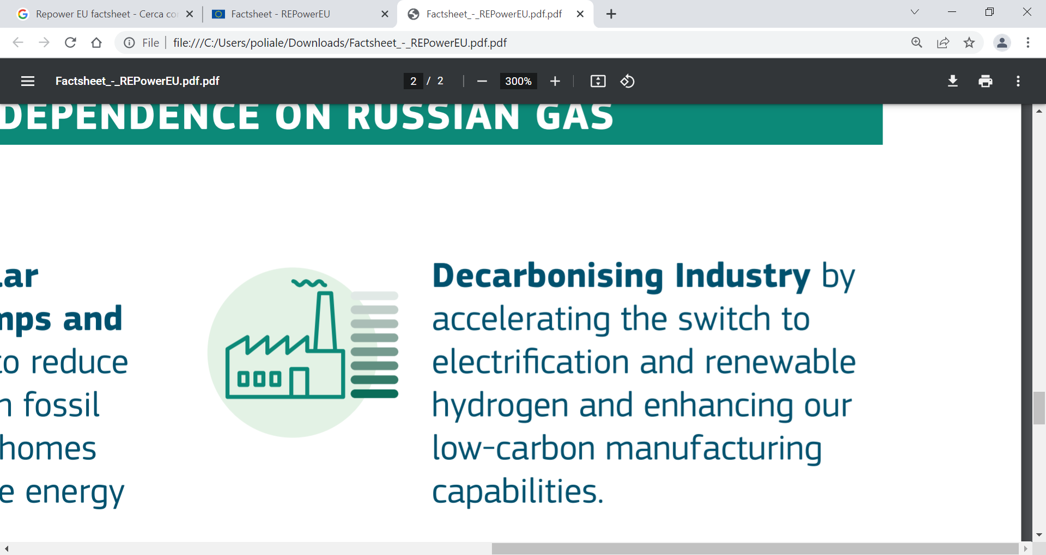
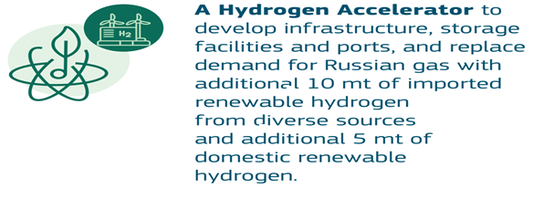
REPowerEU (5/2022) - hydrogen
Joint European action for more affordable, secure and sustainable energy
Urgent action on prices
REPowerEU
Refilling gas storage for next winter

Slide 15
Key priorities for 2022 – 2023
Please communicate EU via concrete projects!
CEF WP 2021-2023 calls
CEF Alternative Fuel Facility (€292m for 24 projects in 23 Member States (9/2022)
Launch of transport investment under regional funds (including on urban mobility)
Implementation of transport investment in RRF national plans
Horizon Europe work programmes, partnerships and missions
InvestEU Sustainable Investment Window
Key priority 2023-2024: Update of National energy and climate plans in follow-up of the adopted legislation

Slide 16

Thank you
© European Union 2020
Unless otherwise noted the reuse of this presentation is authorised under the CC BY 4.0 license. For any use or reproduction of elements that are not owned by the EU, permission may need to be sought directly from the respective right holders.
Notes:
Update/add/delete parts of the copy right notice where appropriate.
More information: https://myintracomm.ec.europa.eu/corp/intellectual-property/Documents/2019_Reuse-guidelines%28CC-BY%29.pdf

